Slide 1



SUBJECT:
Advance Java Technology
TOPIC:
Servlet API
Ser vlets
This work is licensed under a Creative Commons Attribution-NonCommercial-ShareAlike 4.0 International License. You are free to use, distribute and modify it, for noncommercial purposes only, provided you acknowledge the source.

Slide 2
Outline
Servlet Introduction, Servlet Life Cycle(SLC)
Types of Servlet
Servlet Configuration with Deployment Descriptor
Working with ServletContext and ServletConfig objects
Attributes in Servlet
Response and Redirection
Using Request Dispacher
Using sendRedirect Method
Session Tracking
Using Cookies
HTTPSession
Hidden Form Field
URL Rewriting
Filter API, Manipulating Responses using Filter API
Types of Servlet Event: ContextLevel and SessionLevel

Slide 3
Servlets - Introduction
Used to create web application
Resides at server side and generates dynamic web pages.
Servlet technology is robust and scalable because of java language.
Before Servlet, CGI (Common Gateway Interface) scripting language was popular as a server-side programming language. But had many disadvantages.
There are many interfaces and classes in the servlet API:
Servlet, GenericServlet, HttpServlet
ServletRequest, ServletResponse, HttpServletRequest, HttpServletResponse
ServletInputStream, ServletOutputStream
RequestDispatcher, ServletConfig, ServletContext, SingleThreadModel
Filter, FilterConfig, FilterChain

Slide 4
Servlets - Introduction
Servlets run on the HTTP protocol.
HTTP is an request-response protocol.
Client sends a request message to the server
Server returns a response message
Servlets are server-side programs (running inside a web server)
Handle clients' requests
Return a customized or dynamic response for each request.
Servlets → Foundation of the Java server-side technology
Extensions of the servlet technology
JSP (JavaServer Pages), JSF (JavaServer Faces)
Struts, Spring, Hibernate

Slide 5
Servlets - Introduction
Why Build Web Pages Dynamically?
The Web page is based on data submitted by the user
Ex: Results returned from search engine OR order-confirmation pages at online stores
The Web page is derived from data that changes frequently
Ex: A weather report or news headlines page
The Web page uses information from databases or other server-side sources
Ex: an e-commerce site could use a servlet to build a Web page that lists the current price and availability of each item that is for sale.
Comparison with applets
Big applets require long download time
Applets do not have access to all the system resources
Server-side Java solves problems that applets face
Code executed on the server side and only the results sent to client
Servlets can access applications and data sources

Slide 6
Servlets - Features
Servlets:
Extensions to Java-enabled servers
A dynamically loaded module that services requests from a Web server
Executed within the Java Virtual Machine
Runs on the server side
So independent of the browser and not affected by its compatibility issues

Slide 7
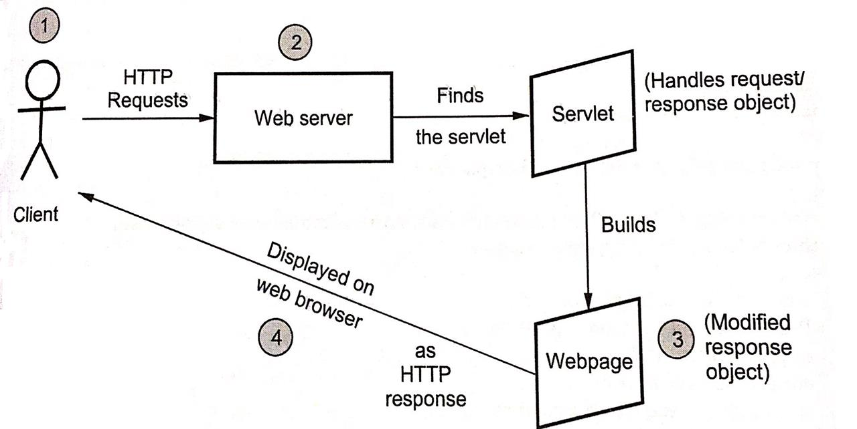
How does a Servlet work? (Execution)
A client makes a request for some servlet, using a Web browser through an URL.
Web browser sends this request to Web server. Web server searches for the requested servlet.
Servlet is executed because of the request and it builds a web page accordingly as a response.
This web page is then displayed to the client. Request made by client is satisfied by the servlet.

Slide 8
A Servlet’s Job
Read data sent by client (form data)
Read data sent by client (request headers)
Generate the results
Send the explicit data back to client (HTML)
Send the implicit data to client (status codes and response headers)

Slide 9
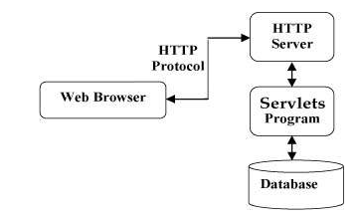
Java Servlet Architecture

Slide 10
Java Servlet Architecture
Two main packages of the servlet architecture:
javax.servlet
Generic interfaces and classes that are implemented and extended by all servlets
interfaces and classes used by the servlet/web container. Not specific to any protocol.
javax.servlet.http
Interfaces and classes used for creating HTTP-specific servlets
Interfaces and classes that are responsible for HTTP requests only
Main heart of servlet architecture is the interface
javax.servlet.Servlet
It provides the framework for all servlets
Defines five basic methods – init, service, destroy, getServletConfig, getServletInfo

Slide 11
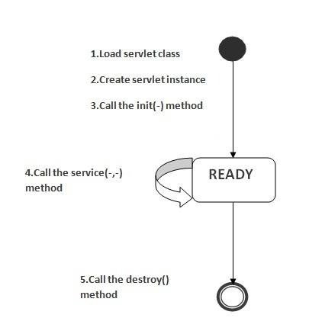
Servlet Life Cycle (SLC)
The web container maintains the life cycle of a servlet instance
SLC Steps:
Servlet class is loaded
Servlet instance is created
init method is invoked
service method is invoked
destroy method is invoked

Slide 12
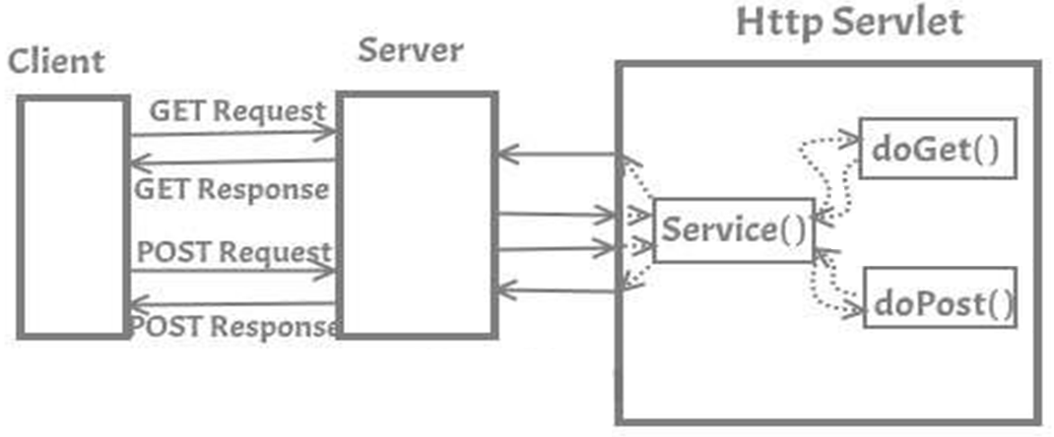
Servlet Life Cycle (SLC)

Slide 13
Servlet Life Cycle (SLC) – Cont.
Servlet class is loaded: Class loader is responsible to load the servlet class. Servlet class is loaded when a 1st request for it is received by web container.
Servlet instance is created: Web container creates an instance of a servlet after loading the servlet class. It is created only once in the servlet life cycle.
init method is invoked: Web container calls the init method only once after creating the servlet instance. It is used to initialize the servlet. It is the life cycle method of the javax.servlet.Servlet interface.
service method is invoked: Web container calls the service method each time when a request for the servlet is received.
destroy method is invoked: Web container calls the destroy method before removing the servlet instance from the service.

Slide 14
Types of Servlets
A servlet can be created by three ways:
By implementing Servlet interface
By inheriting GenericServlet class
By inheriting HttpServlet class
Most used approach → Extending HttpServlet
It provides http request specific method such as doGet(), doPost(), doHead() etc.

Slide 15
Methods of different types of Servlets
1. Servlet (Interface)
a) init (ServletConfig) : void
b) service(ServletRequest,
ServletResponse) : void
c) destroy() : void
d) getServletInfo() : String
e) getServletConfig() : ServletConfig
2. GenericServlet (Abstract Class)
service(ServletRequest, ServletResponse) : void
3. HttpServlet (Abstract Class)
doGet(HttpServletRequest, HttpServletResponse)
doPost (HttpServletRequest, HttpServletResponse)

Slide 16
Servlet interface
Servlet interface provides common behaviorto all the servlets.Servlet interface defines methods that all servlets must implement.
Servlet interface needs to be implemented for creating any servlet (either directly or indirectly).
It provides 3 life cycle methods that are used to initialize the servlet, to service the requests, and to destroy the servlet and 2 non-life cycle methods.

Slide 17
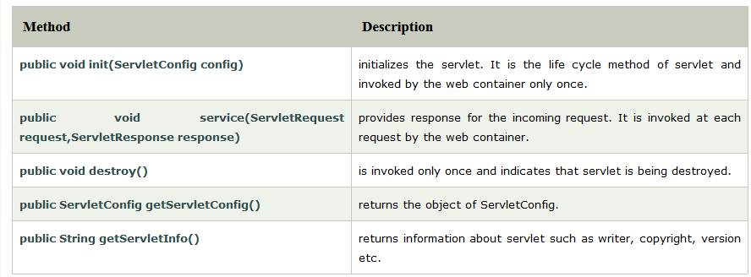
Servlet interface – Methods

Slide 18
GenericServlet class
Implements Servlet, ServletConfig and Serializable interfaces.
Provides the implementation of all the methods of these interfaces except the service method.
Can handle any type of request so it is protocol-independent.
Create a generic servlet by inheriting the GenericServlet class and providing the implementation of the service method.
Methods of GenericServlet class:
public void init(ServletConfig config)
Used to initialize the servlet.
public abstract void service(ServletRequest request,
ServletResponse response)
Provides service for the incoming request.
Invoked at each time when user requests for a servlet.

Slide 19
GenericServlet class (cont.)
Methods of GenericServlet class (cont.):
public void destroy()
Invoked only once throughout the life cycle
Indicates that servlet is being destroyed.
public ServletConfig getServletConfig()
Returns the object of ServletConfig
public ServletContext getServletContext()
Returns the object of ServletContext.
public String getServletInfo()
Returns information about servlet such as writer, copyright, version etc.
public String getInitParameter(String name)
Returns the parameter value for the given parameter name
public Enumeration getInitParameterNames()
Returns all the parameters defined in the web.xml file
public String getServletName()
Returns the name of the servlet object

Slide 20
HttpServlet class
Extends the GenericServlet class
Implements Serializable interface
Provides http specific methods → doGet, doPost, doHead, doTrace etc.
Methods of HttpServlet class:
public void service(ServletRequest rq,ServletResponse rs)
Dispatches the request to the protected service method by converting the request and response object into http type.
protected void service(HttpServletRequest rq, HttpServletResponse rs)
Receives the request from the service method
Dispatches the request to the doXxx() method depending on the incoming http request type

Slide 21
HttpServlet class
Methods of HttpServlet class:
protected void doGet(HttpServletRequest rq, HttpServletResponse rs)
Handles the GET request It is invoked by the web container
protected void doPost(HttpServletRequest rq, HttpServletResponse rs)
Handles the POST request. It is invoked by the web container.
protected void doHead(HttpServletRequest rq, HttpServletResponse rs)
Handles the HEAD request. It is invoked by the web container.
Similarly → doPut, doOptions, doTrace, doDelete
protected long getLastModified(HttpServletRequest req)
Returns the time when HttpServletRequest was last modified since midnight January 1, 1970 GMT.

Slide 22
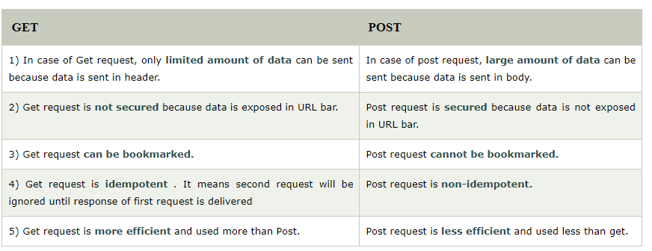
Get Vs Post – methods

Slide 23
Servlet Configuration with Deployment Descriptor
A deployment descriptor (DD) refers to a configuration file for an artifact that is deployed to some container/engine.
In the Java Platform, Enterprise Edition, a deployment descriptor describes how a component, module or application (such as a web application or enterprise application) should be deployed.
It directs a deployment tool to deploy a module or application with specific container options, security settings and describes specific configuration requirements.
XML is used for the syntax of these deployment descriptor files.

Slide 24
Servlet Configuration with Deployment Descriptor
For web applications, the deployment descriptor must be called web.xml and must reside in the WEB-INF directory in the web application root.
For Java EE applications, the deployment descriptor must be named application.xml and must be placed directly in the META- INF directory at the top level of the application .ear file
In Java EE, there are two types of deployment descriptors:
Java EE deployment descriptors
Runtime deployment descriptors

Slide 25
Servlet Configuration with Deployment Descriptor
The Java EE deployment descriptors are defined by the language specification, whereas the runtime descriptors are defined by the vendor of each container implementation.
For example, the web.xml file is a standard Java EE deployment descriptor, specified in the Java Servlet specification, but the sun- web.xml file contains configuration data specific to the Sun GlassFish Enterprise Server implementation.
The web.xml file is located in the WEB-INF directory of your Web application. The first entry, under the root servlet element in web.xml, defines a name for the servlet and specifies the compiled class that executes the servlet.

Slide 26
Working with ServletConfig objects
An object of ServletConfig is created by the web container for each servlet.
This object can be used to get configuration information from web.xml file.
Advantages:
If the configuration information is modified in the web.xml file
No need to change the servlet
Easier to manage the web application
If any specific content is modified regularly

Slide 27
Methods of ServletConfig interface
public String getInitParameter(String name)
Returns the parameter value for the specified parameter name.
public Enumeration getInitParameterNames()
Returns an enumeration of all the initialization parameter names.
public String getServletName()
Returns the name of the servlet.
public ServletContext getServletContext()
Returns an object of ServletContext.
How to get the object of ServletConfig?
getServletConfig() method of Servlet interface returns the ServletConfig object
Syntax of getServletConfig() method
public ServletConfig getServletConfig();

Slide 28
Defining init parameter in web.xml
<web-app>
......
<servlet>
<init-param>
<param-name>parametername</param-name>
<param-value>parametervalue</param-value>
</init-param>
</servlet>
......
</web-app>

Slide 29
Working with ServletContext objects
An object of ServletContext is created by the web container at the time of deploying the project.
This object can be used to get configuration information from web.xml file.
There is only one ServletContext object per web application.
If any information is shared to many servlet, it is better to provide it from the web.xml file using the <context-param> element.
Advantage:
Easy to maintain →If information is changed, no need to modify servlet

Slide 30
Defining context parameter in web.xml
<web-app>
......
<context-param>
<param-name>parametername</param-name>
<param-value>parametervalue</param-value>
</context-param>
......
</web-app>

Slide 31
Usage of ServletContext object
ServletContext object:
Provides an interface between the container and servlet.
Can be used to get configuration information from the web.xml file.
Can be used to set, get or remove attribute from the web.xml file.
Can be used to provide inter-application communication.

Slide 32
Methods of ServletContext interface
public String getInitParameter(String name)
Returns the parameter value for the specified parameter name.
public Enumeration getInitParameterNames()
Returns the names of the context's initialization parameters.
public void setAttribute(String name, Object object)
Sets the given object in the application scope.
public Object getAttribute(String name)
Returns the attribute for the specified name
public Enumeration getInitParameterNames()
Returns names of context's initialization parameters as an Enumeration of String objects
public void removeAttribute(String name)
Removes the attribute with the given name from the servlet context

Slide 33
How to get the ServletContext object?
getServletContext() method of ServletConfig interface returns the object of ServletContext.
getServletContext() method of GenericServlet class returns the object of ServletContext.
Syntax of getServletContext() method:-
public ServletContext getServletContext()

Slide 34
Difference between ServletConfig and ServletContext
The ServletConfig object refers to the single servlet.
The ServletContext object refers to the whole web application.

Slide 35
Attributes in Servlet
Attribute is a variable that the servlet programmers can use to pass any kind of text based information from one servlet to another.
It is just like passing object from one class to another so that we can reuse the same object again and again.
An attribute in servlet is an object that can be set, get or removed from one of the following scopes:
request scope
session scope
application scope

Slide 36
Attributes Specific Methods in Servlets
There are 4 Attribute specific methods of ServletRequest, HttpSession and ServletContext interface
public void setAttribute(String name, Object object): sets the given object in the application scope.
public Object getAttribute(String name): Returns the attribute for the specified name.
public Enumeration getInitParameterNames(): Returns the names of the context's initialization parameters as an Enumeration of String objects.
public void removeAttribute(String name): Removes the attribute with the given name from the servlet context.

Slide 37
RequestDispatcher Interface
The RequestDispatcher interface provides the facility of dispatching the request to another resource it may be html, servlet or jsp.
This interface can also be used to include the content of another resource also.
It is one of the way of servlet collaboration.
There are two methods defined in the RequestDispatcher interface:
public void forward(ServletRequest request, ServletResponse response)throws ServletException, java.io.IOException: Forwards a request from a servlet to another resource (servlet, JSP file, or HTML file) on the server.
public void include(ServletRequest request, ServletResponse response)throws ServletException, java.io.IOException: Includes the content of a resource (servlet, JSP page, or HTML file) in the response.

Slide 38
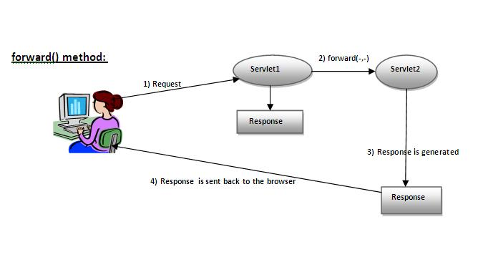
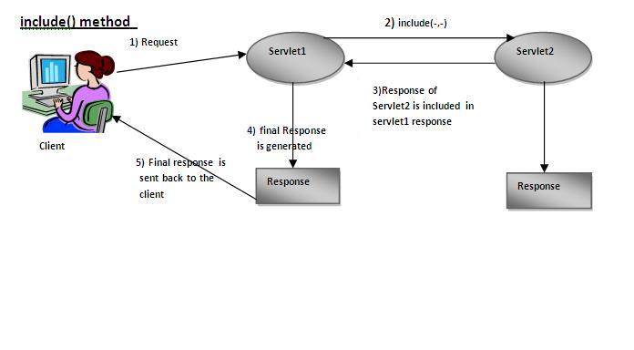
Forward() vs Include () method:

Slide 39
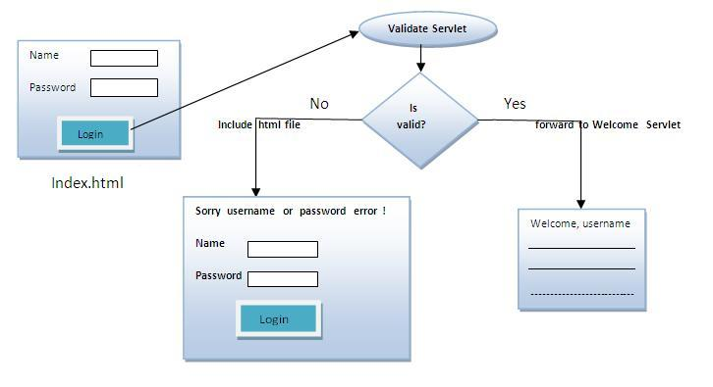
Example of Request Dispatcher interface

Slide 40
SendRedirect in servlet
sendRedirect() method of HttpServletResponse interface can be used to redirect response to another resource, it may be servlet, jsp or html file.
It accepts relative as well as absolute URL.
It works at client side because it uses the url bar of the browser to make another request. So, it can work inside and outside the server.
Syntax of sendRedirect() method
public void sendRedirect(String URL)throws IOException;
Example of sendRedirect() method
response.sendRedirect("http://www.marwadiuniversity.ac.in");

Slide 41
Example of sendRedirect method in servlet
import java.io.*;
import javax.servlet.*;
import javax.servlet.http.*;
public class SendRedirectServlet extends HttpServlet{
public void doGet(HttpServletRequest req,HttpServletResponse res)
throws ServletException,IOException
{
res.setContentType("text/html");
PrintWriter pw=res.getWriter();
response.sendRedirect("http://www.google.com");
pw.close();
}
}

Slide 42
Difference between forward() and sendRedirect() method
Many differences between the forward() method of RequestDispatcher and sendRedirect() method of HttpServletResponse interface.
forward() method | sendRedirect() method
The forward() method works at server side. | The sendRedirect() method works at client side.
It sends the same request and response objects to another servlet. | It always sends a new request.
It can work within the server only. | It can be used within and outside the server.
Example: request.getRequestDispacher("servlet2").forward(request,response); | Example: response.sendRedirect("servlet2");

Slide 43
Custom google search ex. using sendRedirect
index.html
<!DOCTYPE html>
<html>
<head>
<meta charset="ISO-8859-1">
<title>sendRedirect example</title>
</head>
<body>
<form action="GoogleSearchServlet">
<input type="text" name="query">
<input type="submit" value="Google Search">
</form>
</body>
</html>

Slide 44
Custom google search ex. using sendRedirect
GoogleSearch.java
import java.io.*;
import javax.servlet.*;
import javax.servlet.http.*;
public class GoogleSearchServlet extends HttpServlet
{
protected void doGet(HttpServletRequest request, HttpServletResponse response) throws ServletException, IOException
{
String name = request.getParameter("query");
response.sendRedirect("https://www.google.co.in/#q="+name);
}
}

Slide 45
Session Tracking in Servlets
Session simply means a particular interval of time.
Session Tracking is a way to maintain state (data) of an user. It is also known as session management in servlet.
Http protocol is a Stateless Protocol so we need to maintain state using session tracking techniques.

Slide 46
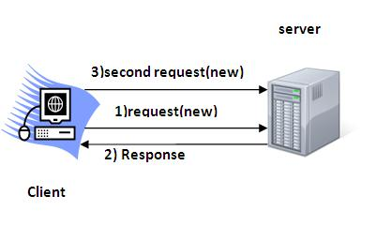
Session Tracking (Cont.)
Http protocol is a stateless protocol so we need to maintain state using session tracking techniques.
Each time user requests to the server, server treats the request as the new request.

Slide 47
Session Tracking (Cont.)
Why use Session Tracking?
To recognize a particular user.
Session Tracking Techniques
Cookies
Hidden Form Field
URL Rewriting
HttpSession object

Slide 48
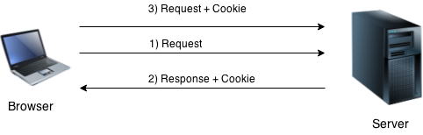
Cookies in Servlet
A cookie is a small piece of information that is persisted between the multiple client requests.
A cookie has a name, a single value, and optional attributes such as a comment, path and domain qualifiers, a maximum age, and a version number.

Slide 49
Cookies (Cont.)
How Cookie works??
By default, each request is considered as a new request.
In cookies technique, we add cookie with response from the servlet.
So cookie is stored in the cache of the browser.
After that if request is sent by the user, cookie is added with request by default. Thus, we recognize the user as the old user.

Slide 50
Cookies (Cont.)
Types of Cookie
There are 2 types of cookies in servlets.
Non-persistent cookie
Persistent cookie
Non-persistent cookie
It is valid for single session only.
It is removed each time when user closes the browser.
Persistent cookie
It is valid for multiple session.
It is not removed each time when user closes the browser.
It is removed only if user logout or signs out.

Slide 51
Cookie class & its constructor
javax.servlet.http.Cookie class provides the functionality of using cookies
Constructor | Description
Cookie ( ) | constructs a cookie.
Cookie (String name, String value) | constructs a cookie with a specified name and value.

Slide 52
Useful Methods of Cookie class
Method | Description
public void setMaxAge(int expiry) | Sets the maximum age of the cookie in seconds.
public String getName() | Returns the name of the cookie. The name cannot be changed after creation.
public String getValue() | Returns the value of the cookie.
public void setName(String name) | changes the name of the cookie.
public void setValue(String value) | changes the value of the cookie.

Slide 53
How to create Cookie?
//creating cookie object
Cookie ck=new Cookie("user","MarwadiUniv");
//adding cookie in the response
response.addCookie(ck);

Slide 54
How to delete Cookie?
//deleting value of cookie
Cookie ck=new Cookie("user","");
//changing the maximum age to 0 seconds
ck.setMaxAge(0);
//adding cookie in the response
response.addCookie(ck);

Slide 55
How to get Cookies?
Cookie ck[ ]=request.getCookies();
for( int i = 0 ; i < ck.length ; i++ )
{
//printing name and value of cookie
out.print("<br>"+ck[i].getName()+" : "+ck[i].getValue());
}

Slide 56
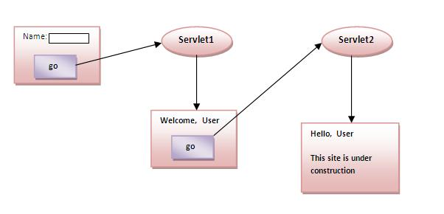
Simple example of Servlet Cookies

Slide 57
Advantage of Cookies
Advantage of Cookies
Simplest technique of maintaining the state.
Cookies are maintained at client side.
Disadvantage of Cookies
It will not work if cookie is disabled from the browser.
Only textual information can be set in Cookie object.

Slide 58
Hidden Form Field
In case of Hidden Form Field a hidden (invisible) textfield is used for maintaining the state of an user.
In such case, we store the information in the hidden field and get it from another servlet. This approach is better if we have to submit form in all the pages and we don't want to depend on the browser.
<input type="hidden" name="uname" value="Vimal Jaiswal">

Slide 59
Hidden Form Field (Cont.)
Real application of hidden form field
It is widely used in comment form of a website. In such case, we store page id or page name in the hidden field so that each page can be uniquely identified.

Slide 60
Hidden Form Field (Cont.)
Advantage of Hidden Form Field
It will always work whether cookie is disabled or not.
Disadvantage of Hidden Form Field:
It is maintained at server side.
Extra form submission is required on each pages.
Only textual information can be used.

Slide 61
URL Rewriting
In URL rewriting, we append a token or identifier to the URL of the next Servlet or the next resource.
We can send parameter name/value pairs using the following format:
url?name1=value1&name2=value2&…
A name and a value is separated using an equal = sign, a parameter name/value pair is separated from another parameter using the ampersand(&).
When the user clicks the hyperlink, the parameter name/value pairs will be passed to the server. From a Servlet, we can use getParameter() method to obtain a parameter value.

Slide 62
URL Rewriting (Cont.)
url?name1=value1&name2=value2&…
A name and a value is separated using an equal = sign.
A parameter name/value pair is separated from another parameter using the ampersand(&).
When the user clicks the hyperlink, the parameter name/value pairs will be passed to the server.
From a Servlet, we can use getParameter() method to obtain a parameter value.

Slide 63
URL Rewriting (Cont.)
Advantage of URL Rewriting
It will always work whether cookie is disabled or not (browser independent).
Extra form submission is not required on each pages.
Disadvantage of URL Rewriting
It will work only with links.
It can send Only textual information

Slide 64
HttpSession interface
In such case, container creates a session id for each user.
The container uses this id to identify the particular user.
An object of HttpSession can be used to perform two tasks:
bind objects
view and manipulate information about a session, such as the session identifier, creation time, and last accessed time.

Slide 65
HttpSession interface (Cont.)
How to get the HttpSession object ?
The HttpServletRequest interface provides two methods to get the object of HttpSession:
public HttpSession getSession():Returns the current session associated with this request, or if the request does not have a session, creates one.
public HttpSession getSession(boolean create):Returns the current HttpSession associated with this request or, if there is no current session and create is true, returns a new session.

Slide 66
Filter API
Like servlet filter have its own API.
The javax.servlet package contains the three interfaces of Filter API:
Filter
FilterChain
FilterConfig

Slide 67
Servlet Filter
A filter is an object that is invoked at the pre-processing and post-processing of a request.
It is mainly used to perform filtering tasks such as conversion, logging, compression, encryption and decryption, input validation etc.
The servlet filter is pluggable, i.e. its entry is defined in the web.xml file, if we remove the entry of filter from the web.xml file, filter will be removed automatically and we don't need to change the servlet.
So maintenance cost will be less.

Slide 68
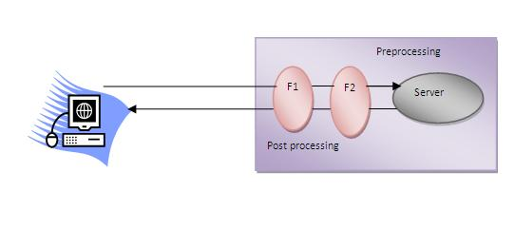
Servlet Filter (Cont.)
A filter is an object that is invoked at the pre-processing and post-processing of a request.
.

Slide 69
Exploring the Need of Filters
Let’s take an example of a web application that formats the data to be presented to clients in a specific format, say Excel.
However at later point of time, the clients may require data in some other format, such as HTML, PDF, or word.
In such a situation, instead of modifying the code every time to change the format of data, a filter can be created to transform data dynamically in the required formats.

Slide 70
Need of Filters (Cont.)
Usage of Filter
recording all incoming requests
logs the IP addresses of the computers from which the requests originate
conversion
data compression
encryption and decryption
input validation etc.
Advantages of Filter
Filter is pluggable.
One filter don't have dependency onto another resource.
Less Maintenance

Slide 71
Filter Life Cycle
The filter interface calls the following methods during the life cycle of a filter :
The init( ) method :
Refers to the method that is invoked by the web container only once when filter is initialized
The doFilter( ) method :
Refers to the method that is invoked each time a user requests a resource, such as a servlet to which the filter is mapped.
When the doFilter( ) method is invoked, the servlet container passes the ServletRequest, ServletResponse, and FilterChain objects
The destroy( ) method :
Refers to the method that is invoked when the filter instance is destroyed.

Slide 72
Filter Interface
For creating any filter, you must implement the Filter interface. Filter interface provides the life cycle methods for a filter.
Method | Description
public void init (FilterConfig config) | init() method is invoked only once. It is used to initialize the filter.
public void doFilter (ServletRequest req, ServletResponse res, FilterChain chain) | doFilter() method is invoked every time when user request to any resource, to which the filter is mapped. It is used to perform filtering tasks.
public void destroy( ) | This is invoked only once when filter is taken out of the service.

Slide 73
How to define a Filter?
We can define filter in the same was as we define a servlet.
web.xml
<web-app>
<filter>
<filter-name>...</filter-name>
<filter-class>...</filter-class>
</filter>
<filter-mapping>
<filter-name>...</filter-name>
<url-pattern>...</url-pattern>
</filter-mapping>
</web-app>

Slide 74
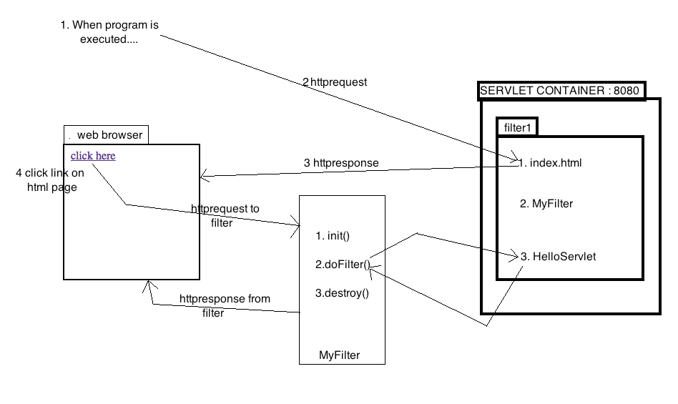
Simple Example of Filter

Slide 75
FILES NEEDED TO BE CREATED:
index.html / index.jsp
MyFilter.java
HelloServlet.java
web.xml

Slide 76
1. index.html
<a href="servlet1">click here</a>

Slide 77
2. Filter (MyFilter)
import java.io.*;
import javax.servlet.*;
public class MyFilter implements Filter{
public void init (FilterConfig arg0) throws ServletException { }
public void doFilter (ServletRequest req, ServletResponse resp, FilterChain chain)
throws IOException, ServletException {
PrintWriter out=resp.getWriter();
out.print("filter is invoked before");
chain.doFilter(req, resp);//sends request to next resource
out.print("filter is invoked after");
}
public void destroy( ) { }
}

Slide 78
3. Servlet : HelloServlet
import java.io.*;
import javax.servlet.*;
import javax.servlet.http.*;
public class HelloServlet extends HttpServlet {
public void doGet(HttpServletRequest request, HttpServletResponse response)
throws ServletException, IOException {
response.setContentType("text/html"); // For setting MIME TYPE
PrintWriter out = response.getWriter(); // creating a writer object
out.print("<br>welcome to servlet<br>");
}
}

Slide 79
4. web.xml
<servlet>
<servlet-name>HelloServlet</servlet-name>
<servlet-class>HelloServlet</servlet-class>
</servlet>
<servlet-mapping>
<servlet-name>HelloServlet</servlet-name>
<url-pattern>/servlet1</url-pattern>
</servlet-mapping>
<filter>
<filter-name>f1</filter-name>
<filter-class>MyFilter</filter-class>
</filter>
<filter-mapping>
<filter-name>f1</filter-name>
<url-pattern>/servlet1</url-pattern>
</filter-mapping>
Same as given
in html file
Same in both the filter
and filter mapping tags

Slide 80
4. web.xml
<servlet>
<servlet-name>HelloServlet</servlet-name>
<servlet-class>HelloServlet</servlet-class>
</servlet>
<servlet-mapping>
<servlet-name>HelloServlet</servlet-name>
<url-pattern>/servlet1</url-pattern>
</servlet-mapping>
<filter>
<filter-name>f1</filter-name>
<filter-class>MyFilter</filter-class>
</filter>
<filter-mapping>
<filter-name>f1</filter-name>
<url-pattern>/servlet1</url-pattern>
</filter-mapping>
Same as given
in html file
Same in both filter
and filter mapping tag

Slide 81
FilterChain interface
The object of FilterChain is responsible to invoke the next filter or resource in the chain. This object is passed in the doFilter method of Filter interface. The FilterChain interface contains only one method:
public void doFilter(HttpServletRequest request, HttpServletResponse response): it passes the control to the next filter or resource.

Slide 82
FilterConfig
An object of FilterConfig is created by the web container. This object can be used to get the configuration information from the web.xml file.
Methods of FilterConfig interface
public void init(FilterConfig config):
init() method is invoked only once it is used to initialize the filter.
public String getInitParameter(String parameterName):
Returns the parameter value for the specified parameter name.
public java.util.Enumeration getInitParameterNames():
Returns an enumeration containing all the parameter names.
public ServletContext getServletContext():
Returns the ServletContext object

Slide 83
Event handling in Servlets
When a request is mapped to a servlet, the Web container creates the instance of the servlet class and then initializes the servlet by calling the init() method.
Once the init() method is executed, the service() method gets executed with the Request and Response parameters.
After the service() method execution, the web container may call the destroy method if the Web container does not require the servlet.
Different events of the Servlet life cycle can now received and particular methods can be called on the basis of these event.
Depending on the type of event, a listener class (context listener or session listener or request listener) is defined.

Slide 84
Servlet Events
Following events can occur with Servlets
Initializing and destroying Servlets
Adding, removing or replacing attributes in Servlet Context
Creating, activating, invalidating a session
Adding, removing or replacing attributes in a Servlet session

Slide 85
Event classes and interfaces
Event classes
ServletRequestEvent
ServletContextEvent
ServletRequestAttributeEvent
ServletContextAttributeEvent
HttpSessionEvent
HttpSessionBindingEvent
Event interfaces
ServletRequestListener
ServletRequestAttributeListener
ServletContextListener
ServletContextAttributeListener
HttpSessionListener
HttpSessionAttributeListener
HttpSessionBindingListener
HttpSessionActivationListener

Slide 86
Types of Event Listeners
Context Listeners are used to notify a class when the context is initialized or destroyed or when an attribute is added or removed to the web context.
Session Listeners are used to notify a class when the session is initialized, destroyed, activated or when an attribute is added, replaced or removed.
Request Listeners are used to notify a class when the request is coming into scope for a servlet or the request is getting out of scope for a servlet. A request is defined as coming into scope when it is about to enter the first servlet or servlet filter.

Slide 87
Request Level events
Request Level events: There are two event listeners for request level events
ServletRequestListener interface is implemented to notify the request coming in scope and going out of scope for a servlet.
ServletRequestAttributeListener interface is implemented to notify the changes (addition, replacement or removal) in the request attributes.

Slide 88
Servlet Context Level events
ServletContextListener interface is implemented to notify the initialization or destruction of the Servlet.
ServletContextAttributeListener interface is implemented to notify the changes (addition, replacement or removal) in the Servlet Context attributes

Slide 89
Servlet Session Level events
The Servlet session level events refer to events that are used to maintain the client’s session.
HttpSessionListener interface is implemented to notify the initialization or destruction of the Http Session.
HttpSessionActivationListener interface is implemented to notify when a sessions object change from one VM to another.
HttpSessionAttributeListener interface is implemented to notify the changes (addition, replacement or removal) in the HttpSession attributes

Slide 90
HttpSessionEvent and HttpSessionListener
HttpSessionEvent is notified when session object is changed.
Corresponding Listener interface for this event is HttpSessionListener.
What operations can we perform?
Counting total and current logged-in users,
Maintaining a log of user details such as login time, logout time etc.
Methods of HttpSessionListener interface
Two methods declared in the HttpSessionListener interface which must be implemented by the servlet programmer to perform some action:
public void sessionCreated(HttpSessionEvent e): is invoked when session object is created.
public void sessionDestroyed(ServletContextEvent e): is invoked when session is invalidated.

Slide 91
Example of ServletContextEvent and ServletContextListener
index.html
MyListener.java
FetchData.java

Slide 92
index.html
<a href="servlet1">fetch records</a>

Slide 93
MyListener.java
import javax.servlet.*;
import java.sql.*;
public class MyListener implements ServletContextListener
{
public void contextInitialized(ServletContextEvent event) {
try{
Class.forName("oracle.jdbc.driver.OracleDriver");
Connection con=DriverManager.getConnection(
"jdbc:oracle:thin:@localhost:1521:xe","system","oracle");
//storing connection object as an attribute in ServletContext
ServletContext ctx=event.getServletContext();
ctx.setAttribute("mycon", con);
}catch(Exception e){e.printStackTrace();}
}
public void contextDestroyed(ServletContextEvent arg0) {}
}

Slide 94
FetchData.java
import java.io.*;
import javax.servlet.*;
import javax.servlet.http.*;
import java.sql.*;
public class FetchData extends HttpServlet {
public void doGet(HttpServletRequest request, HttpServletResponse response) throws ServletException, IOException {
response.setContentType("text/html");
PrintWriter out = response.getWriter();
try{
//Retrieving connection object from ServletContext object
ServletContext ctx=getServletContext();
Connection con=(Connection)ctx.getAttribute("mycon");
//retieving data from emp32 table
PreparedStatement ps=con.prepareStatement("select * from emp32",
ResultSet.TYPE_SCROLL_SENSITIVE,ResultSet.CONCUR_UPDATABLE);
ResultSet rs=ps.executeQuery();
while(rs.next()){
out.print("<br>"+rs.getString(1)+" "+rs.getString(2));
}
con.close();
}catch(Exception e){e.printStackTrace();}
out.close();
}
}

Slide 95
Example of HttpSessionEvent and HttpSessionListener
Aim: To count total and current logged-in users
index.html: to get input from the user.
MyListener.java: A listener class that counts total and current logged-in users and stores this information in ServletContext object as an attribute.
First.java: A Servlet class that creates session and prints the total and current logged-in users.
Logout.java: A Servlet class that invalidates session.

Slide 96
index.html
<form action="servlet1">
Name:<input type="text" name="username"><br>
Password:<input type="password" name="userpass"><br>
<input type="submit" value="login"/>
</form>

Slide 97
MyListener.java
import javax.servlet.*;
import javax.servlet.http.*;
public class CountUserListener implements HttpSessionListener
{
ServletContext ctx=null;
static int total=0,current=0;
public void sessionCreated(HttpSessionEvent e)
{
total++;
current++;
ctx = e.getSession().getServletContext();
ctx.setAttribute("totalusers", total);
ctx.setAttribute("currentusers", current);
}
public void sessionDestroyed(HttpSessionEvent e) {
current--;
ctx.setAttribute("currentusers",current);
}
}

Slide 98
First.java
import java.io.*;
import javax.servlet.*;
import javax.servlet.http.*;
public class First extends HttpServlet {
public void doGet(HttpServletRequest request,
HttpServletResponse response)
throws ServletException, IOException {
response.setContentType("text/html");
PrintWriter out = response.getWriter();
String n=request.getParameter("username");
out.print("Welcome "+n);
HttpSession session=request.getSession();
session.setAttribute("uname",n);
//retrieving data from ServletContext object
ServletContext ctx=getServletContext();
int t=(Integer)ctx.getAttribute("totalusers");
int c=(Integer)ctx.getAttribute("currentusers");
out.print("<br>total users= "+t);
out.print("<br>current users= "+c);
out.print("<br><a href='logout'>logout</a>");
out.close();
}
}

Slide 99
Logout.java
import java.io.*;
import javax.servlet.*;
import javax.servlet.http.*;
public class LogoutServlet extends HttpServlet {
public void doGet(HttpServletRequest request,
HttpServletResponse response)
throws ServletException, IOException {
response.setContentType("text/html");
PrintWriter out = response.getWriter();
HttpSession session=request.getSession(false);
session.invalidate();//invalidating session
out.print("You are successfully logged out");
out.close();
}
}

